Slide 1
TECHNICAL COMMUNICATION

Slide 2
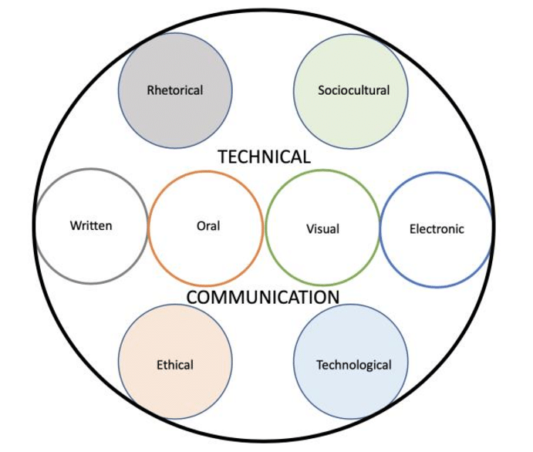

Slide 3
PURPOSE OF TECHNICAL COMMUNICATION
Goal of technical communication is to transmit important information as effectively and efficiently as possible
Information that allows an individual and the individual around you to do the jobs well.

Slide 4
Channels of Technical Communication

Slide 5
listening
Writing
Speaking
visuals
mathematics

